Slide 1
ISTQB®
WorldwideSoftwareTesting
PracticesReport
2015 - 2016
2015 - 2016
w w w . i s t q b . o r g

Slide 3
MessagefromthePresident
ExecutiveSummary
SurveyQuestionsandAnalysis
03
05
06
06
08
12
16
18
22
24
27
Backgroundsof Respondents
OrganizationalAspectsofTesting
EconomicAspectsofTesting
TestingintheSDLC
SkillsandCareerPaths
ToolsandAutomation
TestProcessesandTechniques
ImprovementOpportunitiesintheTestingActivities
Credits
28

Slide 4
“The survey covers several topics,
ranging from organizational and
budgetary aspects, to techniques,
processes, tools, through skills
and competencies;
we think it provides useful
information for all the
professionals involved in the
testing market, as well as
direction for the further evolution
of the ISTQB® scheme. ”
Gualtiero Bazzana, ISTQB® President
ISTQB® Worldwide Software Testing Practices Report 2015-2016 | www.istqb.org
02

Slide 5
MESSAGE FROM THE PRESIDENT
Gualtiero Bazzana, ISTQB® President
ISTQB® (International Software Testing Qualifications Board - www. istqb. org) has created the world’s most successful scheme for certifying software testers. As of June 2015, ISTQB® has administered well over 560,000 exams and issued more than 400,000 certifications in over 110 countries world-wide, with a growth rate of about 50,000 certifications per year.
As a nonprofit-organization with its mission of “advancing the software testing profession”, ISTQB® regularly conducts international online surveys to assess the trends in testing industry.
After the “2013 ISTQB® Effectiveness Survey”, in which we collected market feedback on the impacts of ISTQB® certifications, in 2015 we conducted a survey looking at the “ Worldwide Software Testing Practices”, the results of which are published in this report.
The survey covers several topics, ranging from organizational and budgetary aspects, to techniques/ processes/ tools, through skills and competencies; we think it provides useful information for all the professionals involved in the testing market, as well as direction for the further evolution of the ISTQB® scheme. This is an exciting time in the testing industry and the survey data will help the significant evolution that ISTQB® is currently undertaking to ensure we develop and maintain syllabi that continue to reflect changing testing practices and that meet market demands.
The survey was designed by the ISTQB® Marketing Working Group and endorsed by ISTQB® Member boards, accredited training providers and exam providers, collecting more than 3,200 responses from 89 countries.
I would like to thank all of you who responded to the survey; your valuable feedback will contribute significantly to the future of the ISTQB® scheme.
ISTQB® Worldwide Software Testing Practices Report 2015-2016 | www.istqb.org
03

Slide 6
“With its reach to more than
89 countries and about 3,200
respondents, ISTQB®
Worldwide Software Testing
Practices Report lays the
foundations for an open discussion
about the most important topics in
the software testing community.”
ISTQB Marketing Working Group
04
ISTQB® Worldwide Software Testing Practices Report 2015-2016 | www.istqb.org

Slide 7
EXECUTIVESUMMARY
The main highlights from the report are:
Budgets assigned to testing are large and keep on growing
The typical IT/ R&D project budget allocated to software testing ranges between 11% and 40%. This is in line with the World Quality Report 2015-16 that indicates an average expenditure of 26% for 2014 and 35% for 2015. Also in line with the World Quality Report is the fact that budgets are expected to grow in the near future, with about 60% of the respondents expecting an increase of the budgets allocated to testing, with an average expected growth rate for next year to be about 14%.
Agile based SDLCs are being adopted ahead of traditional ones (Waterfall or V-Model)
Agile methodologies are significantly increasing in popularity; this emphasizes the need to have appropriate testing processes and techniques for Agile, as well as certification of testing competences.
Segregation of duties has become a standard practice from an organizational point of view
In close to 80% of the cases, the responsibility for software testing is assigned to in-house test teams. Adoption of “segregation of duties” is further confirmed by the fact that in most cases (84%) the test team does not report to Development.
Training and certification of competences are key factors in improving test skills
In addition to training on the job (72%), organizations are improving the competency level of their test teams mostly by encouraging their employees to undertake relevant certifications (51%) and formal training (46%) This means that learning of the theory and the practicing of hands-on activities are both seen as important, and should be used in combination.
^{Test tools are widely adopted}
Adoption of testing tools is becoming commonplace, especially for defect tracking, test execution, test automation, test management, performance testing and test design.
^{Test automation is a hot topic}
Test automation has become very widespread in the market, with 72% adoption. 40% of the respondents suggested that the percentage of automated test cases in use is well beyond 20%. Test tool/automation consulting is also the most sought service from external providers, with test automation being the area with highest improvement potential.
Testing requires a wide range of skills and competencies
A good tester should be able to combine Technical Skills (especially on test design and test execution tools) together with Soft Skills and Domain Knowledge.
Important career paths are available for testers and test managers
Testers typically evolve into technical analysts and test managers who can progress to become Test Department Managers or Project Managers.
The decision of “When to stop testing” is mainly based on requirements coverage
Requirements coverage is by far the most adopted criterion to decide when to stop testing. It is a bit worrisome to see that constraints imposed by scheduling is the second criterion, knowing that this is a dangerous practice
Use cases and exploratory testing are the most adopted test techniques in the business practices
Use cases and exploratory testing are more extensively applied than traditional black-box techniques (like BVA or equivalence classes). Coverage-based white box techniques are used by no more than 20% of the sample.
Performance, usability and security tests are gaining traction
The top three non-functional testing activities that test teams normally perform are performance (63%), usability (56%) and security testing (39%).
Several improvement opportunities are recognized
The survey indicates that there are still significant improvement opportunities in test automation, test process, communication and test techniques that have been cornerstones of the ISTQB® syllabi since the certification scheme began.
ISTQB® Worldwide Software Testing Practices Report 2015-2016 | www.istqb.org
05

Slide 8
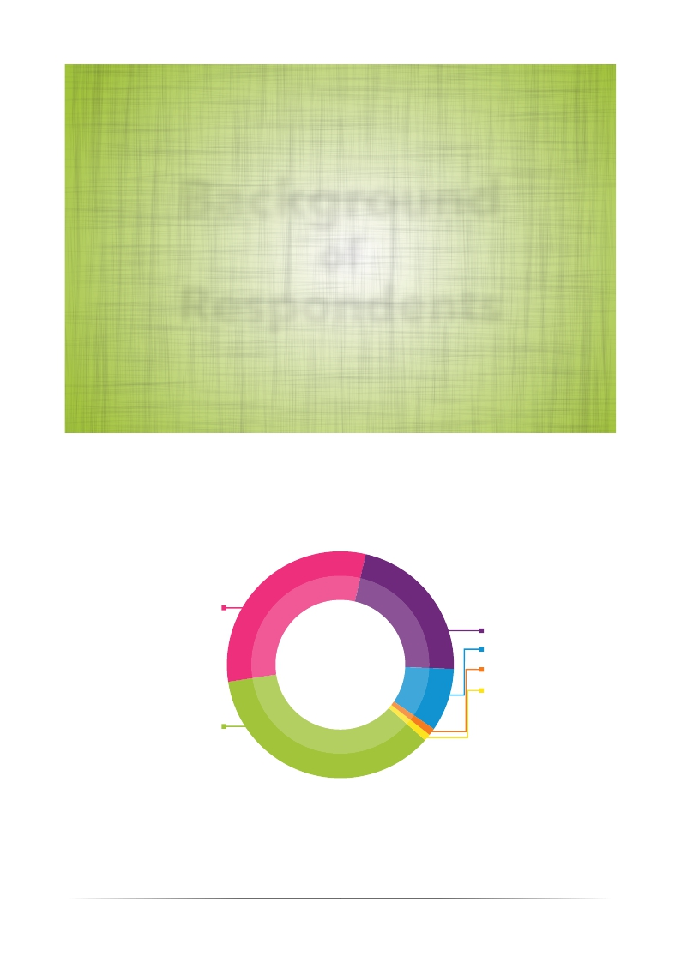
Background
of
Respondents
In which region do you currently work?
Asia
31%
22%
9%
1%
1%
NorthAmerica
SouthAmerica
Africa
Oceania
Europe
36%
06
ISTQB® Worldwide Software Testing Practices Report 2015-2016 | www.istqb.org

Slide 9
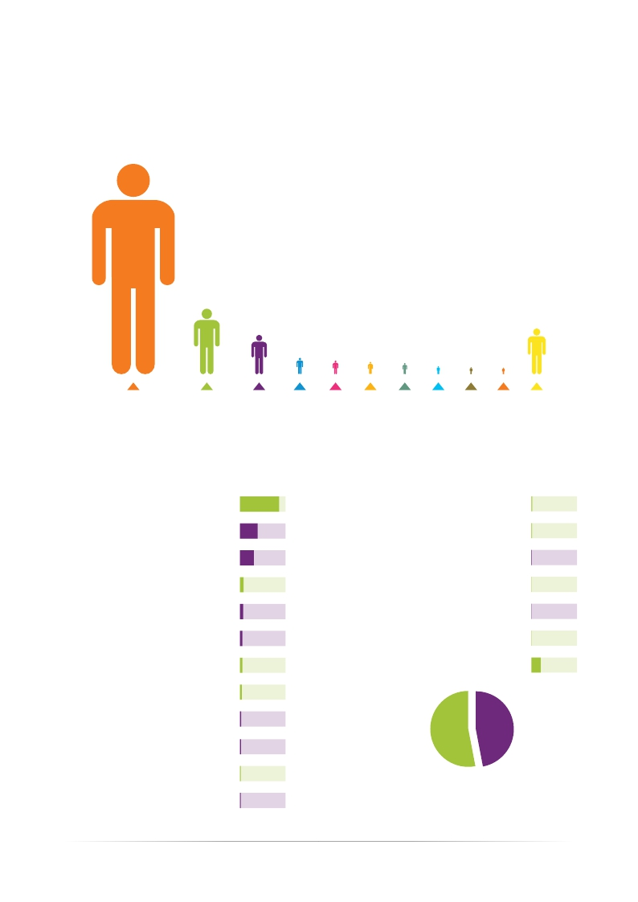
To which industry does your organization belong?
1580
Information
Technologies
492
Financial
Services
296
Telecom, Media and
Entertainment
124 Healthcare and Medical
104 Consumer Products, Retail and Distribution
93 Public Sector
84 Automotive
61 Education
53 Transportation
50 Manufacturing
344 Other
What is your current job title?
Tester
Test Leader
Test Manager
Business Analyst
Manager
Project Manager
Developer
System Analyst
1288
582
459
123
106
80
80
61
Development Manager
Academic / Professor
Operations Manager
Enterprise Architect
R&D Manager
Database Admin
Other
24
18
10
8
5
3
305
CEO / General Manager
Business Unit Manager
IT Architect
CIO / IT Manager
40
33
28
26
53%
TECHNICAL
47%
MANAGERS
“Respondents distribution
according to functions”
ISTQB® Worldwide Software Testing Practices Report 2015-2016 | www.istqb.org
07

Slide 10
Organizational
Aspects
of
Testing
ISTQB® Worldwide Software Testing Practices Report 2015-2016 | www.istqb.org
08

Slide 11
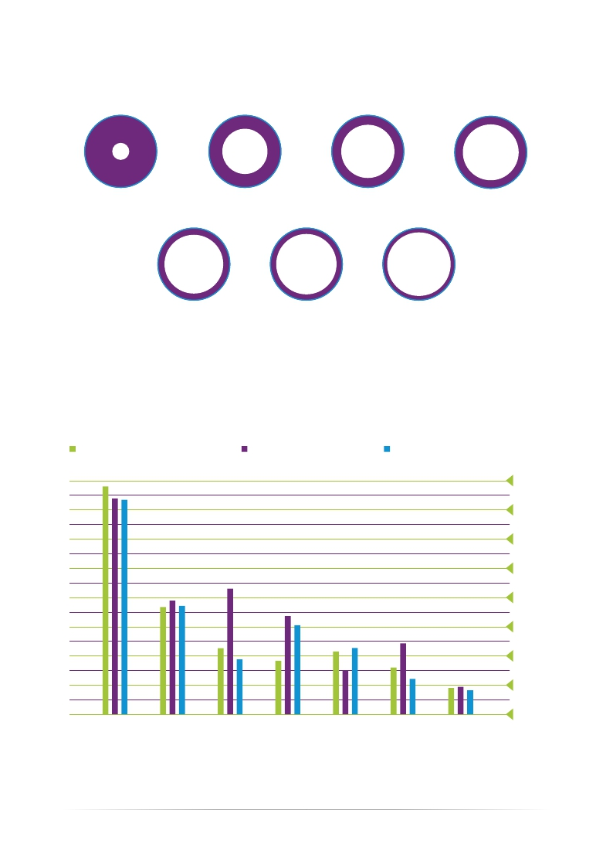
Who is responsible for software testing in your company? (Multiple answers were allowed.)76,7%
38,1%
Developers
27,1%
End Users
23,5%
In-sourced test team
In-house test team
19,5%
Distributed test team
17,3%
Off-shore test team
8,3%
Near-shore test team
In close to 80% of the cases, the responsibility of SW testing is assigned to an in-house test team; this confirms the increasing adoption of “segregation of duties”, that is one of the key factors for the effectiveness of testing activities.
Segmentation by Industy
Information Technologies
Financial Services
Telecom, Media and Entertainment
80%
70%
60%
50%
40%
30%
20%
10%
0%
In - House
Test Team
Developers
End Users
In-Sourced
Test Team
Distributed
Test Team
Off - Shore Near - Shore
Test Team
Test Team
ISTQB® Worldwide Software Testing Practices Report 2015-2016 | www.istqb.org
09

Slide 12
To whom does the test team report?
46% Project Manager
15% Other
11% Development Manager
11% CIO / IT Manager
R&DManager5%
Operation Manager 5%
Business Analyst Manager 4%
CEO / General Manager 3%
Test teams are in most case sunder the supervision of project managers(46%). 11%of the mare reporting to development manager and CIO/IT manager. Only 3% are reporting to the CEO/General Manager.
10
ISTQB® Worldwide Software Testing Practices Report 2015-2016 | www.istqb.org

Slide 13
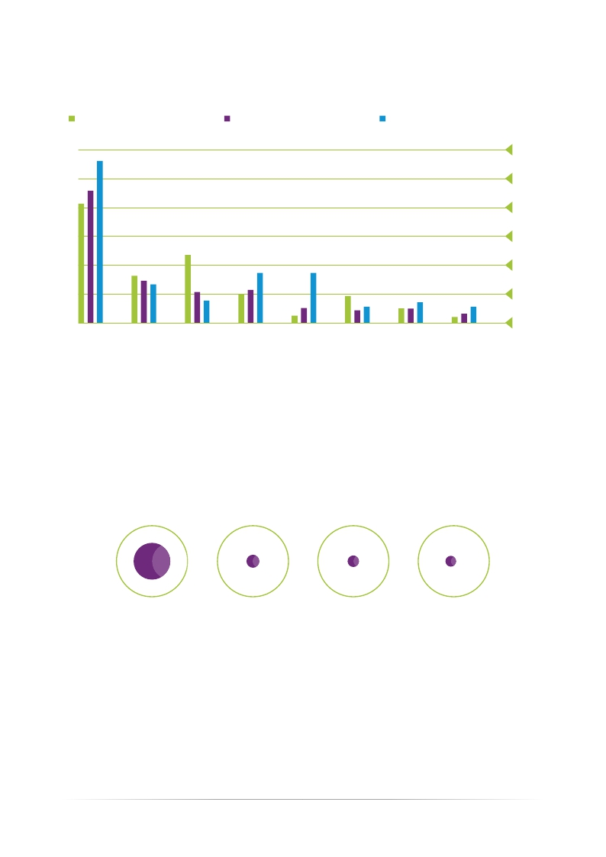
Segmentation by Industry
Financial Services
All Industries
Telecom, Media and Entertainment
60%
50%
40%
30%
20%
10%
0%
Project
Manager
Other
CIO / IT
Manager
Development
Manager
R&D
Manager
Business
Analyst
Operation
Manager
CEO
General
Manager
Menager
The testing function in Financial Services reports to the CIO/IT manager in more than 20% responses, and only in 6% for Telecom, Media.
Segmentation by Function
51%
To Operation
18%
To Business
16%
To Development
15%
Other
Wide adoption of “segregation of duties” is confirmed by the fact that in most cases (84%) the test team does not report to Development
ISTQB® Worldwide Software Testing Practices Report 2015-2016 | www.istqb.org
11

Slide 14
Economic
Aspects
of
Testing
ISTQB® Worldwide Software Testing Practices Report 2015-2016 | www.istqb.org
12

Slide 15
What percent of atypical IT/R&D project budget is
allocated to software testing?
21,7%
0% - 11%
42,3%
11% - 25%
26,9%
26% - 40%
9,1%
More Than 40%
The large majority of respondents indicate budgets between 11% and 40%.
This is inline with World Quality Report 2015-16 that in dicates an average expenditure of 26% for 2014 and 35% for 2015.
Segmentation by Industry
Information Technologies
Telecom, Media and Entertainment
Financial Services
50%
40%
30%
20%
10%
0%
0% - 11%
11% - 25%
26% - 40%
More Than
40%
Telco/ Media companies devote more of their budget to testing activities than do IT or Financial Services companies.
ISTQB® Worldwide Software Testing Practices Report 2015-2016 | www.istqb.org
13

Slide 16
What is your expect ation for your organization’s
software testing budget in the next 12 months?
59,2%
Growth
16,6% 1%-10% Growth
14,7% 11%-20% Growth
31%
Stable
9,8%
Decrease
6,5% Slight Decrease
3,3% Signification Decrease
11,9% 21%-30% Growth
6,2% 31%-40% Growth
4,1% 41%-50% Growth
5,7% MoreThan50%Growth
About60%oftherespondentsexpectanincreaseofthebudgetsallocatedtotesting;thisconfirmsthegrowingtrend exhibited in the World Quality Report 2015-16, which forecasts that by 2018 the IT budget allocated to QA & testing
will rise to 40%.
Average expected growth is 14% which is in line with the forecasted CAGR of the Global Testing Market in 2015-2019 in the Technavio Report www.technavio.com)
To which test level(s) is most of your budget allocated? (Multiple answers were allowed.)
71,3%
System
48,7%
Integration
44%
User
Acceptance
24,1%
Unit /
Component
Systemtestingisbyfartheactivityabsorbingmostofthetestingbudget.ThisisinlinewiththeEuroStar2014Survey.
(http://testhuddle.com/practices-attitudes-in-software-testing-study)
14
ISTQB® Worldwide Software Testing Practices Report 2015-2016 | www.istqb.org

Slide 17
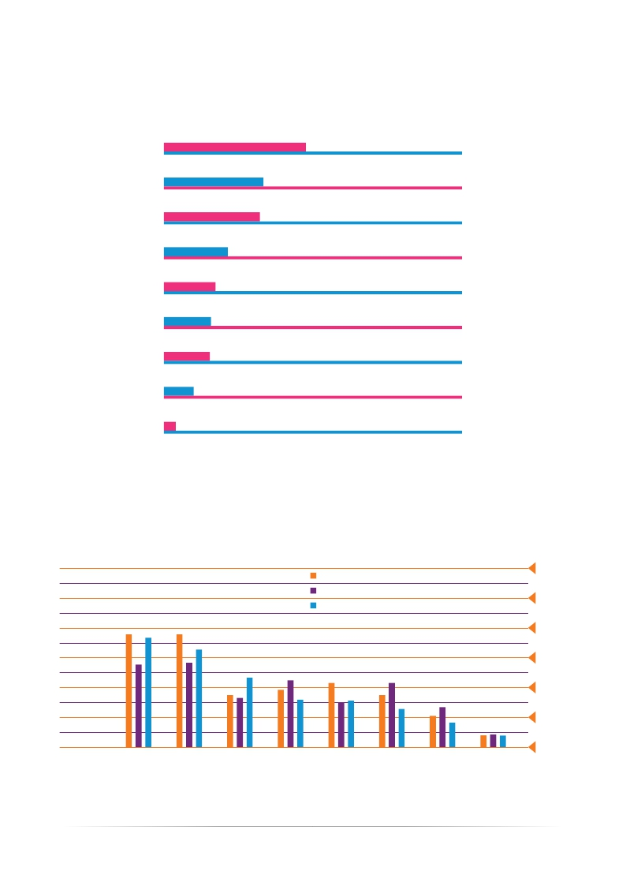
Which of the below services is your organization
Going to obtain from external providers in the next 12
months? (Multiple answers were allowed.)
Test Tool/Automation Consulting
Certification of Testing Competences
Test Training
Will not Obtain any Services
Test Process Consulting
Test Design
Testing Service Charged by Time
Full Outsourcing of Testing Service
Other
47,6%
33,4%
32,2%
21,4%
17,3%
15,8%
15,4%
10%
4%
Test tool/automation consulting (47.6%) is the most sought service from external providers.
Certification of testing competencies (33.4%) and test training (32.2%) deserve a strong interest.
Only 21.4% of the espondents do not plan to benefit from external
services in the next 12 months.
Segmentation by Industry
Telecom, Media and Entertainment
Financial Services
Information Technologies Technologies
60%
50%
40%
30%
20%
10%
0%
Certification
of
Testing
Competencies
Test
Training
Will not Test
Obtainany Process
Services Consulting
Test Design
Testing Full
Service Outsourcing
Chargedby of Testing
Time Service
Other
ISTQB® Worldwide Software Testing Practices Report 2015-2016 | www.istqb.org
15

Slide 18
Testing
in the
SDLC
ISTQB® Worldwide Software Testing Practices Report 2015-2016 | www.istqb.org
16

Slide 19
Which Software Development Life cycle (SDLC) model
Are you using? (Multiple answers were allowed.)
Agile (Scrum,ExtremeProgramming,Kanban)
Sequential (Waterfall, V-model)
Iterative (Rup, Spiral)
Other
69,6%
53,5%
18,8%
3,2%
Agile based SDLCs are being adopted significantly more often than traditional ones.(Waterfall or V-Model)
Agile methodologies are significantly increasing in popularity; this underlines the need to have appropriate testing
processes and techniques also for Agile, combined with certification of testing competences.
ISTQB® has recently launched a specific certification module
for “Agile Tester” with a strongly positive reply by the market, and in the near future will further extend the certifications on Agile testing
at an Advanced level.
Which activities do you use to find defects before test
execution? (Multiple answers were allowed.)
Formal Review of The Analysis Documents
Formal Review of The Design Documents
Source Code Inspection
Static Analysis Tools
None
Other
84,3%
60,7%
33,7%
30,7%
16,1%
5,3%
Review of the analysis documents/requirements remains the most widespread activity for early detection of defects.
ISTQB® Worldwide Software Testing Practices Report 2015-2016 | www.istqb.org
17

Slide 20
Skills
and
Career
Paths
ISTQB® Worldwide Software Testing Practices Report 2015-2016 | www.istqb.org
18

Slide 21
Whichskillsdoyouexpectfromtesters?
(Multiple answers were allowed.)
81,8%
Test Design Skills
80,6%
Test Execution / Tooling
44,9%
Database Skills
73,5%
Soft Skills (Presentation
Communication...)
39,3%
Programming /
72,4%
Domain Knowledge /
Business Knowledge
2,4%
Other
Scripting Skills
A good tester should be able to combine Technical Skills (especially on test design and test execution tools) together with Soft Skills and Domain Knowledge.
Segmentation by Roles
Technical
Managers
80%
70%
60%
50%
40%
30%
20%
10%
0%
Test Design
Skills
Test
Execution /
Tooling
Soft Skills
(Presentation...)
Domain
Knowledge
/ Business
Knowledge
Database
Skills
Programming
/ Scripting
Skills
Other
The evaluation of the most important test skills does not vary, depending on the role of the testers.
ISTQB® Worldwide Software Testing Practices Report 2015-2016 | www.istqb.org
19

Slide 22
How does your organization improve the competency
Level of your testers? (Multiple answers were allowed.)
72,9%
Training on
the Job
51,9%
Certification of
Competencies
46%
Formal Training
Participation at
Conferences
29,5%
12,2% None
Besides training on the job (72%), organizations are improving the
Competency level of their test teams by encouraging their employees to undertake relevant certifications
(51%) and formal training (46%).
This means that learning theory and practicing hands-on activities are
both seen as important and should be used in combination.
Formal Training and Certification are used in combination by 31% of responders.
This is well in line with the 2013 ISTQB® Effectiveness Survey in which Test Engineers and Test
Managers a like declared to be highly satisfied with the ISTQB® CTFL certification and happy to recommend these to their
colleagues (91% - Test Engineers, 94% - Test Managers)
This is also confirmed by the EuroStar 2014 survey in which 74% of the respondents declared that
certifications are valuable to them.
20
ISTQB® Worldwide Software Testing Practices Report 2015-2016 | www.istqb.org

Slide 23
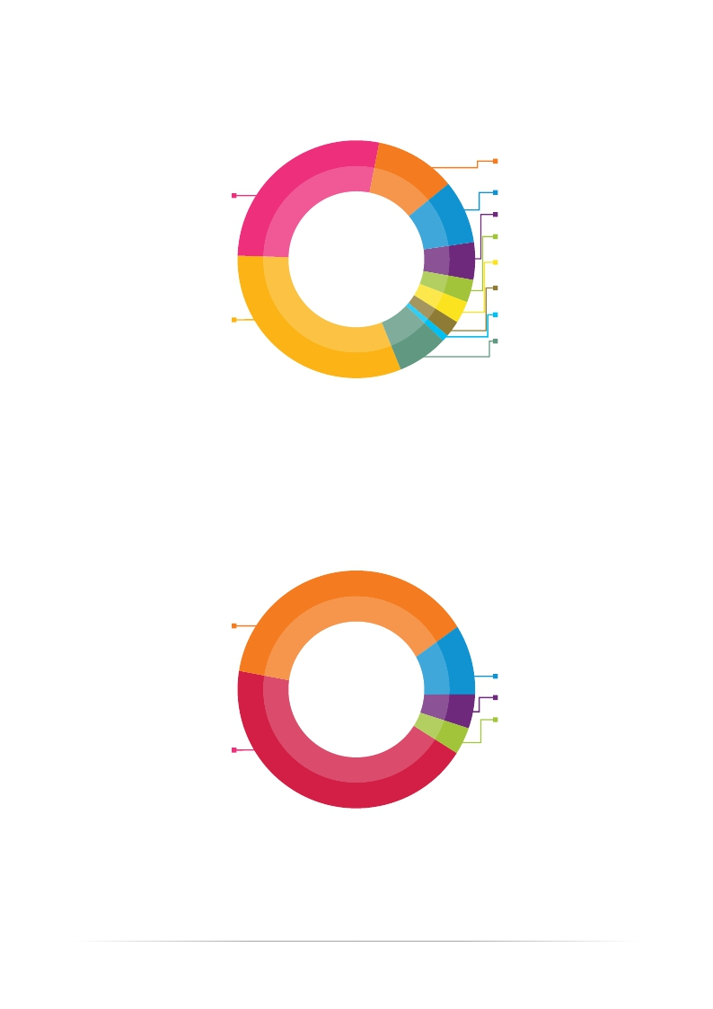
WhichCareerPathismoreCommonforaTesterin Your
Organization?
11% Tester~>TechnicalTestAnalyst
(Performance,Security,Automationetc.)
Tester ~> Test Manager
Tester ~> Test Analyst
27,6%
31,6%
8,6% Tester~>BusinessAnalyst
5,1% Tester ~> Developer
3,1% Developer ~> Tester
3%
BusinessAnalyst~>Tester
2,2% Tester~>ScrumMaster
0,9% Tester ~> IT Architect
7%
Other
In a typical tester’s career path the next step is either becoming a test analyst (31.6%) or a test manager (27.6%).
What could be then ext level in the career path for aTest Manager?
Project Manager
37%
10% Other
5%
4%
Development Manager
CTO/CIO
Test Department Director
44%
The most common next step in the career path for a test manager is becoming test department director (44%) or project manager (37%).
ISTQB® Worldwide Software Testing Practices Report 2015-2016 | www.istqb.org
21

Slide 24
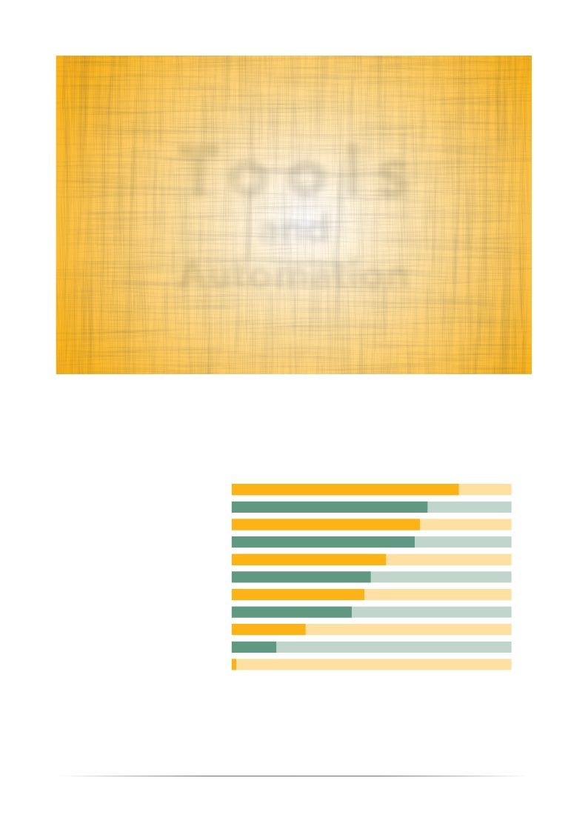
Tools
and
Automation
Which tools do you use in your organization?
(Multiple answers were allowed.)
Defect Tracking
Test Execution
Test Automation
Test Management
Performance Testing
Test Design
RequirementsTraceability
Unit Testing
Static Analysis
Dynamic Analysis
Other
Adoption of testing tools isbecoming commonplace.
81,2%
70%
67,3%
65,4%
55,2%
49,7%
47,4%
42,9%
26,4%
16%
1,6%
Defecttracking(81.2%),testexecution
(70%), test automation (67.3%) and
test management (65.4%) tools are
the most commonly used among test
teams.
Also Performance testing and Test Design tools are used by about a half of the respondents.
22
ISTQB® Worldwide Software Testing Practices Report 2015-2016 | www.istqb.org

Slide 25
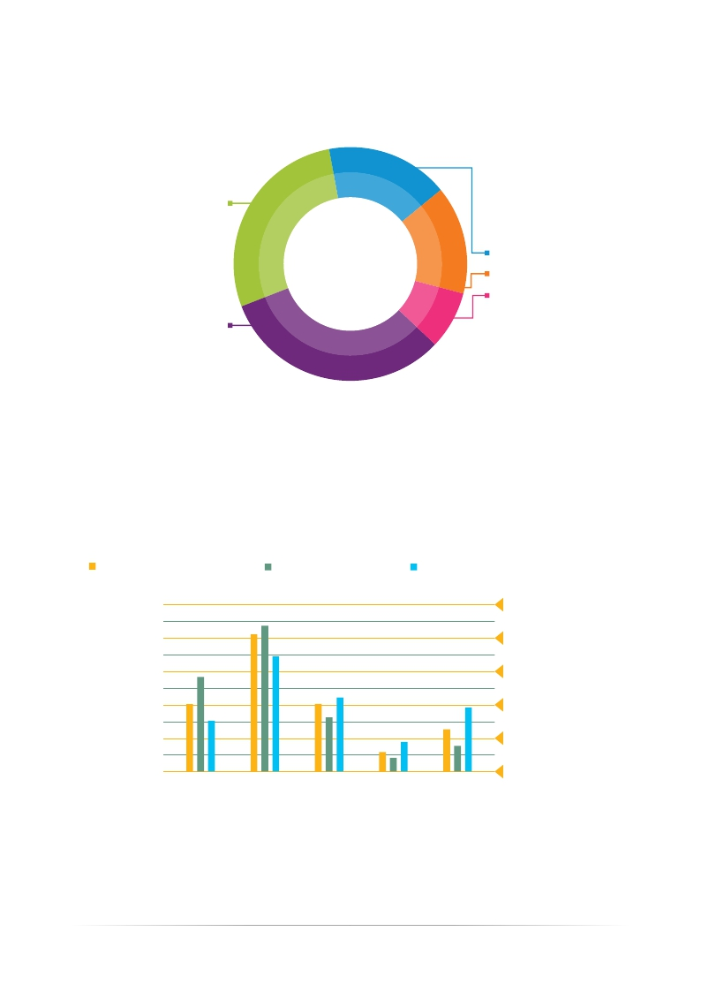
What is the percent age of automated test cases you use with respect to your overall test cases?
No Automation
28%
17% MoreThan50%
15% From 21% to 40%
8%
From 41% to 50%
Less Then 20%
32%
Test automation has become very widespread in the market, with 72% adoption; in 40% of the cases the percentage of automated test cases is well beyond 20%.
Segmentation by Industry
Information Technologies
Financial Services
Telecom, Media and Entertainment
50%
40%
30%
20%
10%
0%
No
Automation
Less Than
20%
From 21%
to 40%
From 41%
to 50%
MoreThan
50%
The use of test automation in the Telecom & Media industries is more prevalent than in IT and Financial Services.
ISTQB® Worldwide Software Testing Practices Report 2015-2016 | www.istqb.org
23

Slide 26
T e s t
Processes
and
Techniques
What are the main objectives of your testing activities?
(Multiple answers were allowed.)
87,3%
To Detect Bugs
67,4%
To Show the System
is Working Properly
52%
To Gain
Confidence
38,4%
To Evaluate the
User Experience
35,3%
To Comply with
Regulations
25,4%
To Be a Customer
Advocate
13,6%
To Have Zero
Defects
2,2%
Other
Top three testing objectives are detecting bugs (87,3%), showing the system is working properly (67,4%) and gaining confidence (52,0%). Evaluating user experience (38,4%), complying with regulations (35,3%), being a customer advocate (25,3%) and having zero defects (13,6%) are the following objectives.
24
ISTQB® Worldwide Software Testing Practices Report 2015-2016 | www.istqb.org

Slide 27
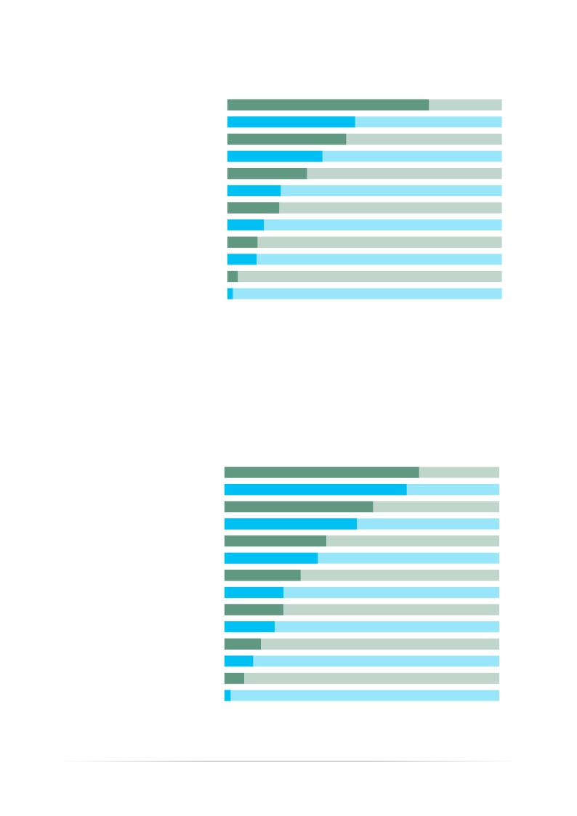
Whatareyourtestexitcriteria? (Multiple answers were allowed.)
Requirements Coverage
Scheduled Deadline
Risk Coverage
User Story Coverage
Percentage of Defects Closed
Budget
Total Number of Defects Found
Decision Coverage
Statement Coverage
Path Coverage
Other
None
73,4%
46,5%
43,3%
34,6%
29%
19,5%
18,9%
13,3%
11%
10,6%
3,8%
2%
Requirements coverage is by far the most adopted criterion to decide when to stop testing. It is a bit worrisome to see that constraints imposed by scheduling is the second criterion, knowing by the quantitative analysis of Capers Jones (http://namcookanalytics.com/about/) that this one of the most dangerous practices in terms of quality and costs throughout the whole life cycle (including maintenance).
Whicharethemostadoptedtesttechniques?
(Multiple answers were allowed.)
Use Case Testing
Exploratory Testing
Checklist Based
Boundary Value Analysis
Error Guessing
Equivalence Partition
Decision Tables
Decision Coverage
State Transition
Statement Coverage
Pair-Wise Testing
Attacks
Classification Tree
Other
70,8%
66,3%
54,1%
48,2%
37%
34%
27,7%
21,5%
21,4%
18,2%
13,2%
10,4%
7,1%
2,2%
Use cases and exploratory testing are more extensively applied than traditional black-box techniques (like BVA or equivalence classes); coverage-based white box techniques are used by no more than 20% of the sample.
ISTQB® Worldwide Software Testing Practices Report 2015-2016 | www.istqb.org
25

Slide 28
Whichofthenon-functionaltestingactivitiesdoesyour
testteamnormallyperform?
(Multiple answers were allowed.)
63%
Performance
56,1%
Usability
38,5%
Security
30,7%
Realiability
29,1%
Accessibility
27,7%
Testability
25,9%
Efficiency
25,6%
Availability
18,9%
Maintainability
18,5%
Interoperatibility
17,5%
Operability
15%
Scalability
12,9%
Recoverability
10,6%
Portability
8,4%
Supportability
%6,5%
None
5,2%
Extensibility
Performance, Usability and Security testing are the top-three nonfunctional testing activities. In the ISTQB® product portfolio evolution road-map these are among the highest priorities.
26
ISTQB® Worldwide Software Testing Practices Report 2015-2016 | www.istqb.org

Slide 29
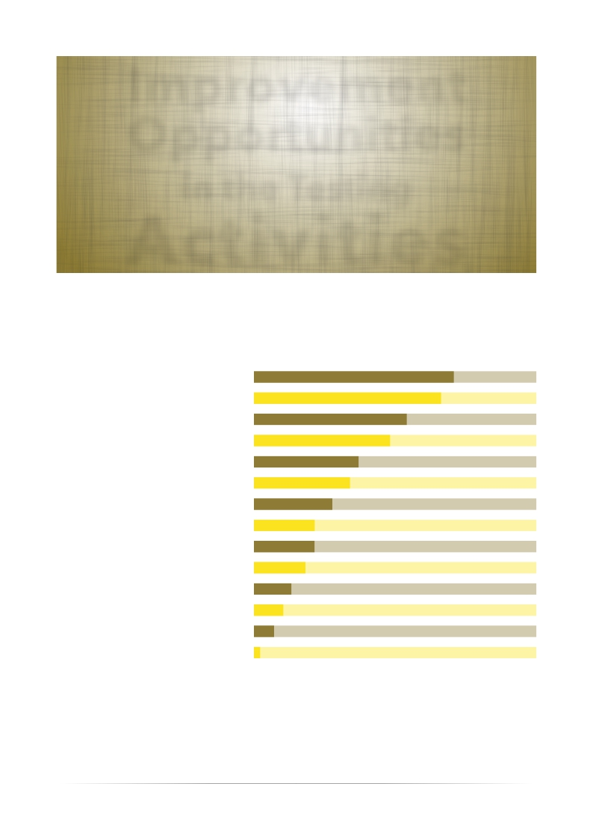
Improvement
Opportunities
in the Testing
Activities
What are the main improvement areas in your testing
activities? (Multiple answers were allowed.)
Test Automation
Knowledge about Test Processes
Communication Between
Development and Testing
Knowledge about Test Design
Maintaining Test Cases
Test Data Preparation
Communication Between
Project Management and Testing
Prioritization
Maintaining Test Scripts
Time
Having Well Trained Personnel
Unrealistic Expectations of
Other Stakeholders from Test Team
Budget
Other
58,5%
46,6%
46,4%
40,7%
38,7%
32,6%
31,1%
29,9%
28,9%
28,9%
27,8%
19,5%
16,2%
1,8%
Test automation confirms to be a very hot topic, because it is at the same time one of the most adopted practices, an activity for which external support is sought and the area with highest improvement potential.
In this respect, ISTQB® is completing additional certification modules dedicated to test automation for both the traditional SDLC and for the Agile context.
The survey indicates that there are still significant improvement opportunities in test process, communication and test techniques, that have been cornerstones of ISTQB® syllabi since the certification scheme began.
ISTQB® Worldwide Software Testing Practices Report 2015-2016 | www.istqb.org
27

Slide 30
CREDITS
Coordinators of the Survey
GualtieroBazzana
ISTQB®, President
ITA-STQB, President
Alten Italia, Managing Director
KorayYitmen
ISTQB®,
Marketing Working Group Member
Turkish Testing Board, President
Keytorc Software Testing Services,
Partner
YanBaron
ISTQB®,
Marketing Working Group Member
ITCB, Executive Board
iMDsoft, Test Manager
28
ISTQB® Worldwide Software Testing Practices Report 2015-2016 | www.istqb.org

Slide 31
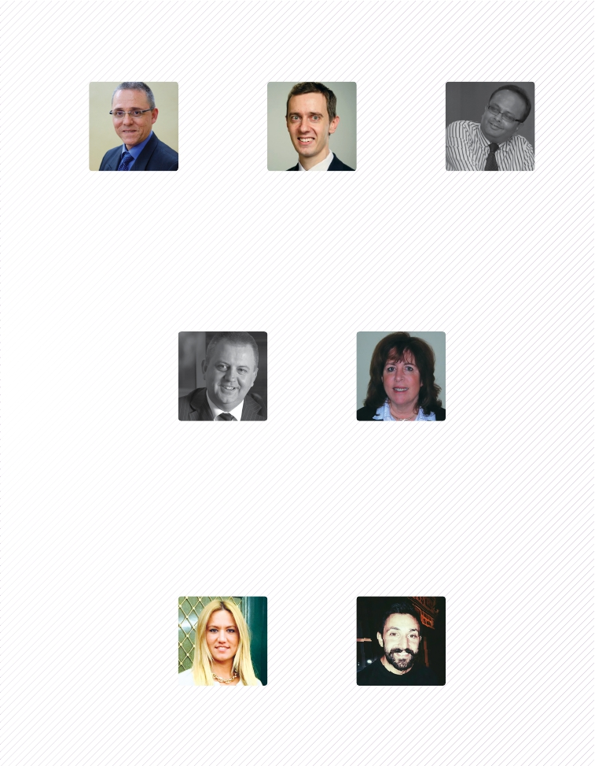
Main Contributors
AlonLinetzki
ISTQB® Marketing WG
Partner Program Lead
Israeli Testing Certification Board,
VicePresident&MarketingDirector
Best-Testing, Founder and
Managing Director
KasparLoog
ISTQB®,
Marketing Working Group Chair
Estonian Testing Board
Browserbite, Founder and CEO
Reviewers
RitendraBanerjee
ISTQB® Marketing Working
Group- Strategy Stream Head;
Awards Panel member
Representative
Indian Testing Board
SALT University
Co founder and CEO
GeoffThompson
ISTQB® Secretary
UK Testing Board Chairman
Consultancy Director,
Experimentus Ltd
PatriciaMcQuaid
ISTQB®MarketingWorkingGroup-Strategy
and Mentoring; Academia projects
Co-founder and Past-President,
American Software Testing
Qualification Board (ASTQB)
Professor of Information Systems,
CaliforniaPolytechnicStateUniversity,USA
Graphical Editing
Merveİçöz
Graphical Editing
OkanCoşkun
Graphic Design
ISTQB® Worldwide Software Testing Practices Report 2015-2016 | www.istqb.org
29

Slide 32
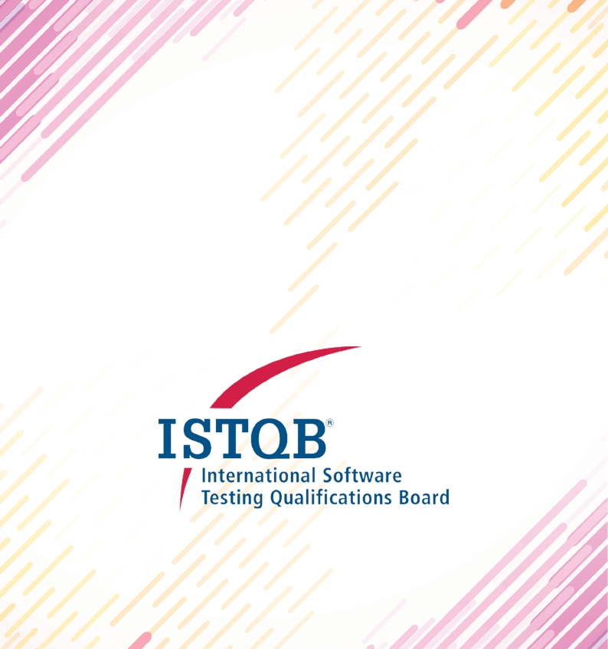
/istqborg
/ISTQBORG
/in/istqborg
ISTQB® Worldwide Software Testing Practices Report 2015-2016 | www.istqb.org | www.istqb.org | 1160 Brussels | Belgium | No. 0889.625.305

